Slide 1
R PROJECT ON Predict Customer Life-time Value for an Auto Insurance Company
BY- BINOYANANDA NANDI

Slide 2
PROJECT OBJECTIVE:
For an Auto Insurance company, predict the conditions effecting customer life time value (CLV). CLV is the total revenue the client will derive from their entire relationship with a customer. Because we don't know how long each customer relationship will be, we make a good estimate and state CLV as a periodic value — that is, we usually say “this customer's 12-month (or 24-month, etc) CLV is “$x”.

Slide 3
SIGNIFICANT VARIABLES
EDUCATION
EMPLOYMENT STATUS
GENDER=MALE
INCOME
MARITIAL STATUS
MONTHLY PREMIMUM AUTO
MONTHS SINCE POLICY INCEPTION
NUMBER OF OPEN COMPLAINTS
NUMBER OF POLICIES

Slide 4
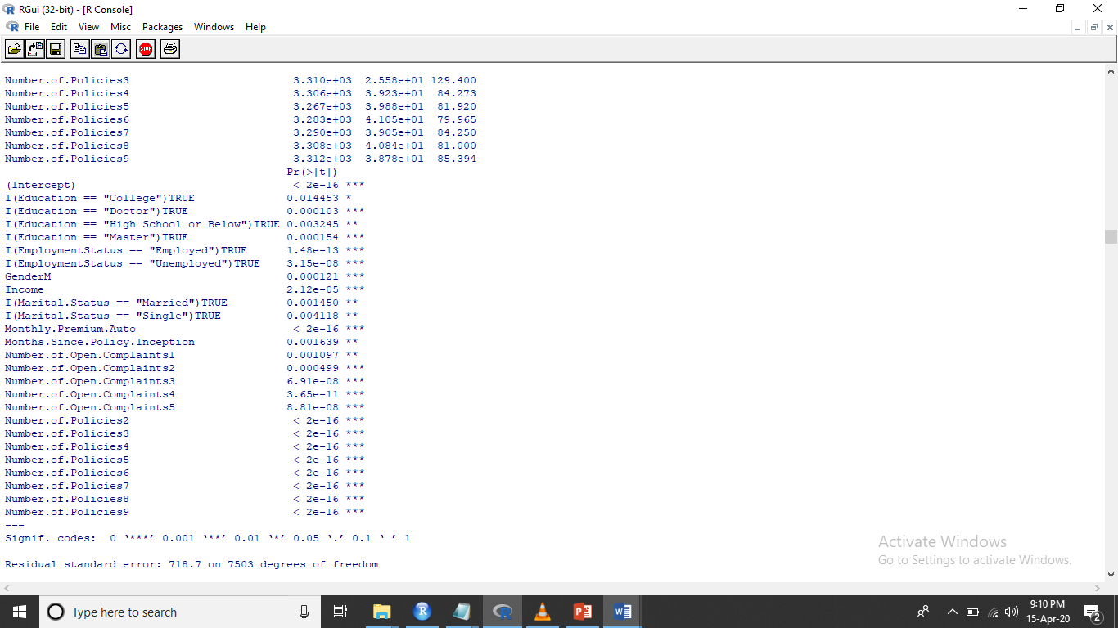

Slide 5
OUTPUT OF THE MODEL
Residual standard error: 718.7 on 7503 degrees of freedom
Multiple R-squared: 0.9334,
Adjusted R-squared: 0.9331
F-statistic: 4203 on 25 and 7503 DF, p-value: < 2.2e-16
R-Sq is saying that the variables are accounting for 93%change in CLV.
R-sq and Adj R-sq are same so we don’t have redundant variable. So adding more variable wont impact the R- sq.
P value less than 0.05 so we are rejecting the Null hypothesis by saying that many variables have co-efficient not equals to 0. So many variables variables have significate impact on CLV

Slide 6
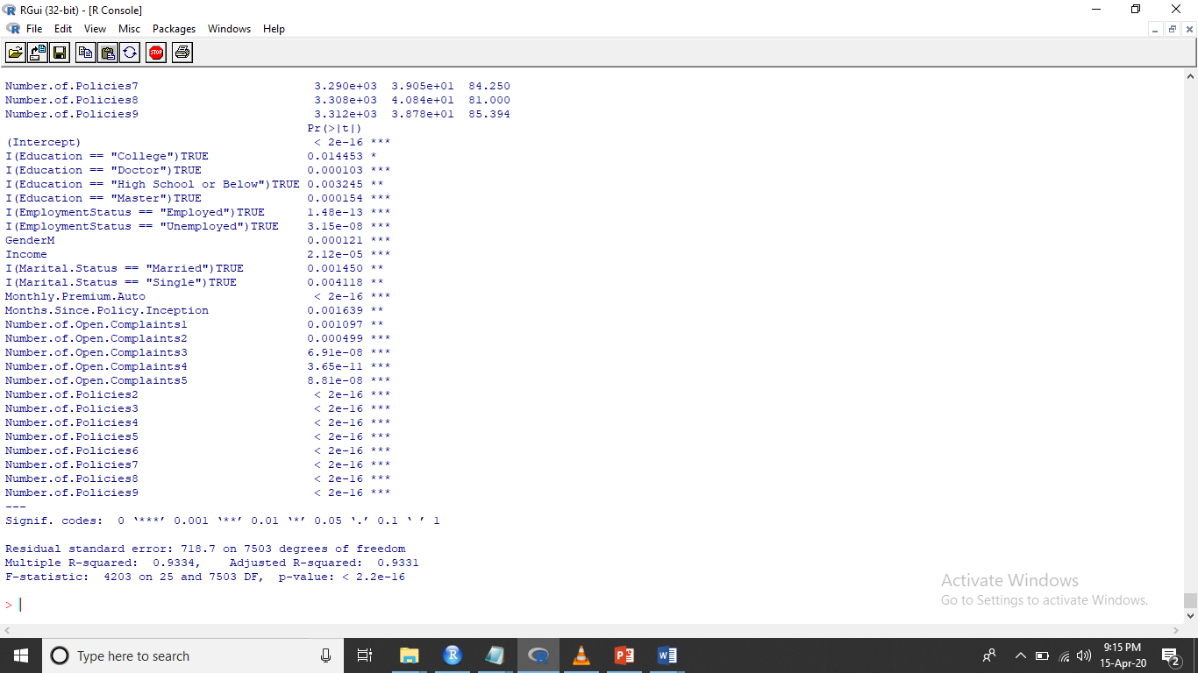

Slide 7
ASSUMPTIONS FROM THE MODEL
RESIDUAL ANALYSIS:
Normality Test is done to check Error the model is making in predicting the CLV from the train dataset.
To check if the Residuals are Normal or not we run Anderson- Darling test.
The P value of Ad-Test shows that p-value < 2.2e-16, so the the assumptions is violated.
MULTI-COLINEARITY :
It says that there should not be any correlation among independent variables
VIF-variance Infation factor test is used to check if there is multicolearity.
If VIF is >2 then we remove the variables since it has correlation with other variables.
Cor function can be used to check individual correlation with other variables . If P is >0.5 the we should remove the variables.

Slide 8
ASSUMPTIONS FROM THE MODEL:
HOMOSEDASTICITY:
Since P value is <0.05 so there is no Homoscedasticity means variance is constant.
The residuals are scattered and not same along the line.
AUTOCORRELATION:
Darbin-Watson Test: Means the residuals should not be correlated.
Since P value is 0 there is little correalation.

Slide 9
ASSUMPTIONS FROM THE MODEL
MAPE:
MAPE is Mean Absolute Percentage Error is the mean error calculation between the Actual Value and the Predicted value.
Lower the MAPE better is the Model. MAPE ranges from 0 to 1.
MAPE is 9.62% which is very low error rate, so the model is good.

Slide 10
SUGGESTIONS
CLV will be more if The person’s Education is a Doctor or has Master rather than a College Student or Unemployed Person. So the focus should be more on on person having Doctor degree or Masters degree to increase the business.
Gender Male is likely to have more CLV than a Female gender. So business with Male gender will be profitable than Female gender.
Married person are likely to have more CLV than Single/divorced.
Policies and No of complaints are an Important factor in increasing the CLV.

Slide 11
THANK YOU.

